Slide 1

Project 3 Data Cleaning 14 March 2022
Giang LE
Rana YOUSSEF

Slide 2


Our dataset: Salary

Slide 3
Database
Our chosen database is about salaries in 1096 unique companies
It’s a huge database with 62642 observations in 1050 locations worldwide
Variables about company, location, experience, gender, title and education of employees in each company

Slide 4
Organisation
Import the data using Pandas.
Examine the data for potential issues (missing data, data inconsistency, outliers, duplicates).
Cleaning and transforming the data with Python
Export clean version of data into MySQL using Pandas.
Analyzing the dataset in MySQL.

Slide 5

Challenges
Short timing
Big dataset
Missing values
Missing detailed explication and documentation of dataset

Slide 6
Cleaning data on Python
Check the columns who have the NaN values
Create a subset who have the useful columns for the further analysis.
Check one by one the columns who have the Nan values and fixit if possible
Check the outlier concerning the years of experience and years at company
Check again the type of all columns; make sure the numeric columns have float or int types.
Clean the name of company and make sure that there are no incorrect names by replacing all special characters, lowercase then capitalize.
For Gender, there are some invalid values, so we change them to NaN

Slide 7
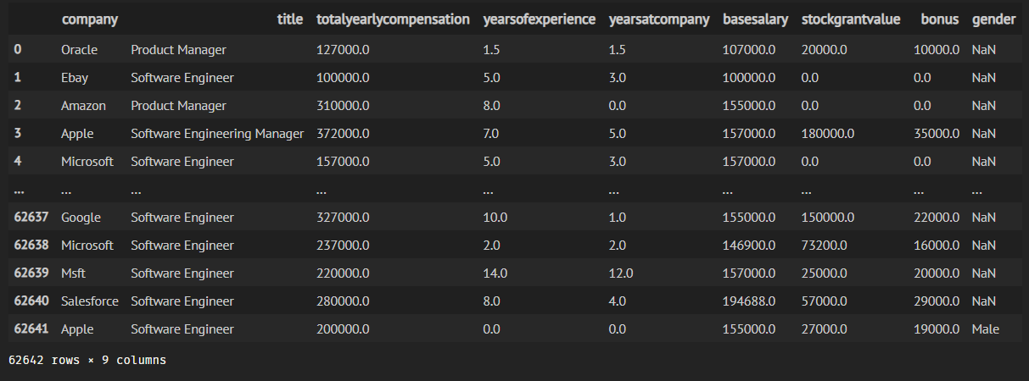
Cleaned Data version

Slide 8
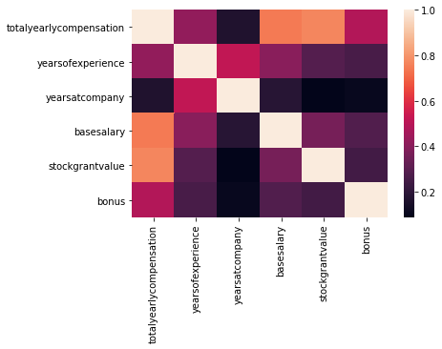
Use heatmap to check the correlation

Slide 9
Working with MySQL
the 20 companies who have the most total yearly compensation
avg salary per title per company
calculate the average year of experiences and years at company of 3 chosen companies (Apple, Microsoft, Google)
Calculate the average compensation per gender per company out of 3 chosen companies.
Calculate the avg salary of Business Analyst Title in 3 chosen companies

Slide 10
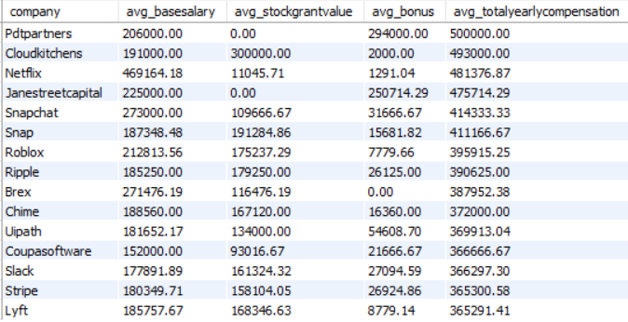
15 highest paying companies

Slide 11
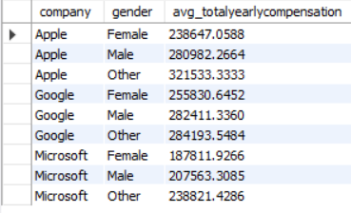
Salaries by gender

Slide 12
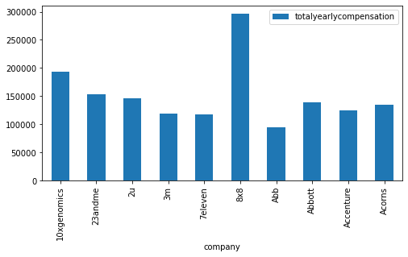
10 top Total yearly compensation companies

Slide 13
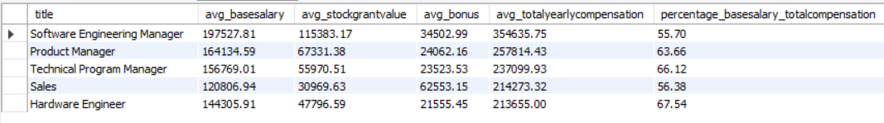
5 best paid titles

Slide 14

AVG years of experiences in 3 chosen companies

Slide 15
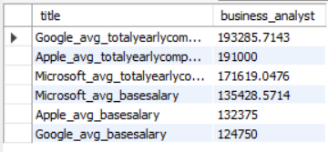
Business Analyst AVG salary in 3 chosen companies

Slide 16
Lessons Learnt
Practice importing and exporting database to and from Pandas.
Practice to clean the data to have the best datatset for further analysis
Exporting csv from pandas to SQL
Get closer to real life dataset
GitHub link:
https://github.com/Rana2305/IronhackLabs_GiangLe/tree/master/Module%201/Project_3

Slide 17
Thanks !

